Slide 1
Year 8 rock cycle revision

Slide 2
Aims
Learning Intentions:
We will be learning about how to prepare ourselves for our topic test
Success Criteria:
We will be able to use our program to revise
We will be able to draw a graphic organiser to figure out what we do and don’t know

Slide 3
Think-pair-share
When you have tests coming up, what do you do to revise?

Slide 4

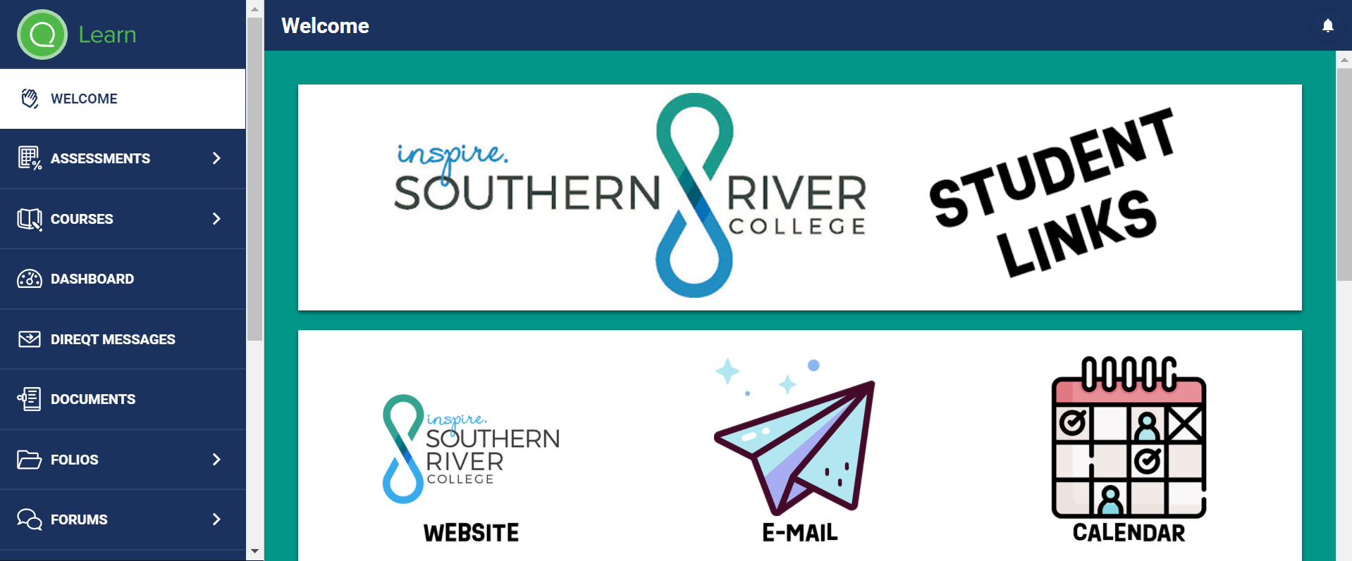
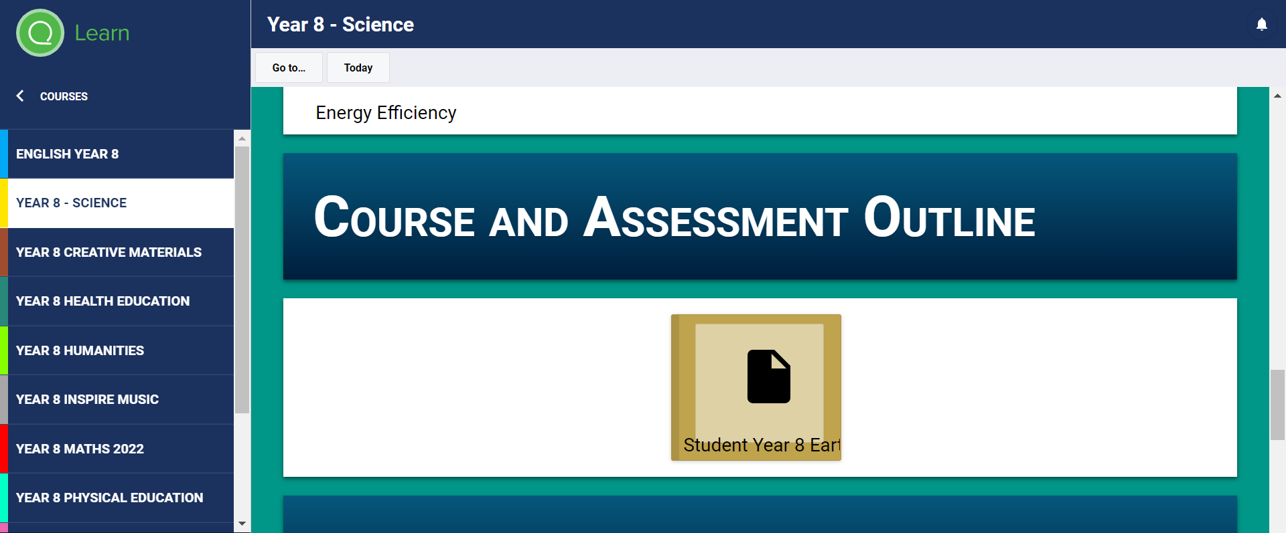
finding your program
Did you know we gave you a file that tells you everything you’re learning about this term? It’s available on SEQTA!
Let’s all navigate to, and open up, the program!

Slide 5
Using your program
Now that you know where to find your program, let’s use it to figure out what we’re learning about!
Where do we think we can find the information about what we did and didn’t learn?
Correct – the learning intentions and success criteria!

Slide 6
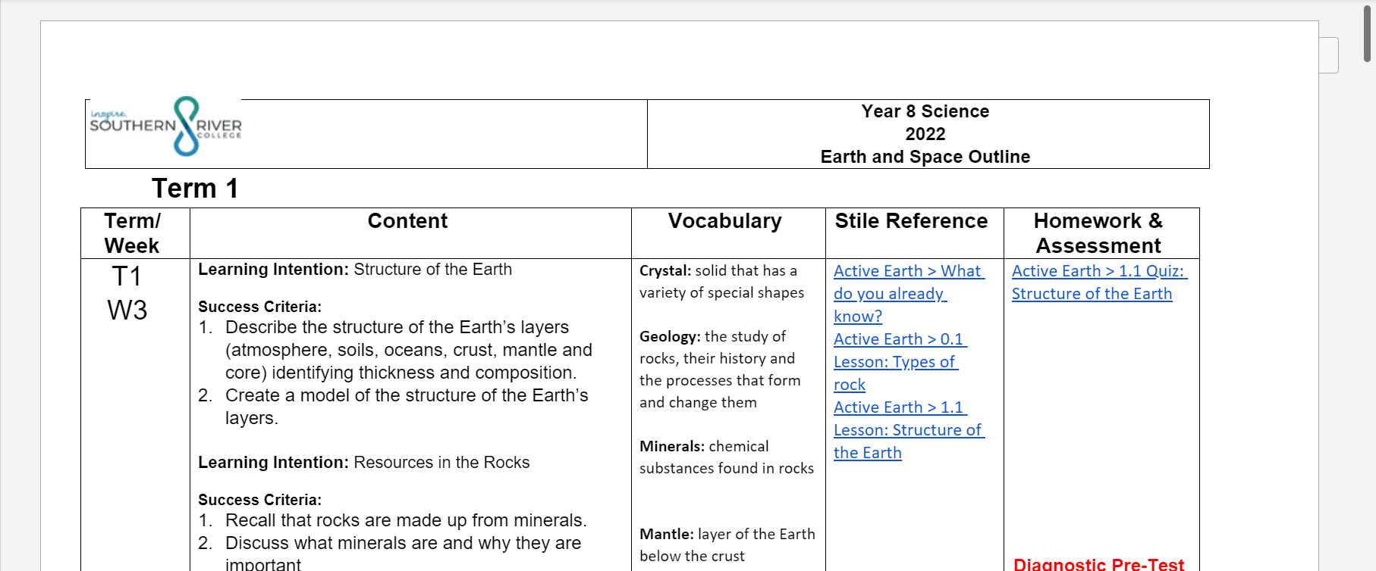
How much do we remember?

Slide 7
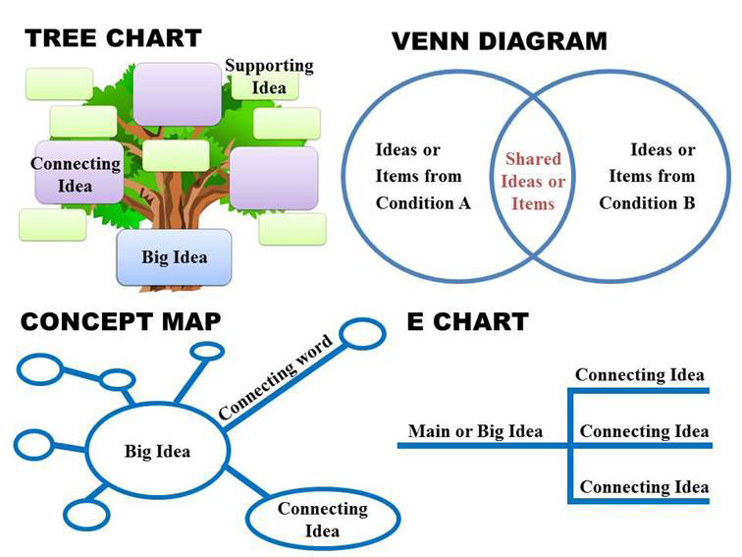
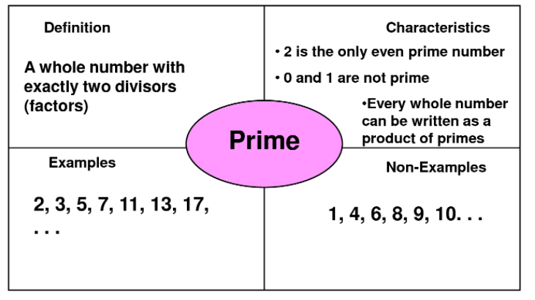
Graphic organisers
One method of studying is to make a graphic organiser that lists everything you need to know and connects the different ideas

Slide 8
Don’t study what you already know!
However, whenever studying, it’s super important not to waste your time!! If you already know something, you don’t need to study it, so you can move on
Let’s use the “Look-Cover-Write-Check” strategy. Using your program, under all the learning intentions, I want you to write everything you remember about that topic in one colour. Then, in another colour, I want you to write down all the success criteria OR topics you forgot to write about!

Slide 9
How to study
Studying doesn’t mean just staring at your book until you know everything – this is a waste of your time!!
Studying means doing meaningful things to help you test your memory and help you remember things you didn’t know
Let’s brainstorm – what are some fun and creative things you can do to help you remember things that aren’t just staring at your notes?

Slide 10
Study techniques
Flash cards
Making fun and creative posters/graphic organisers
Do practice questions at home
Any sort of “look-cover-write-check” technique!
Make up questions you could be asked in a test, and swap with a friend

Slide 11
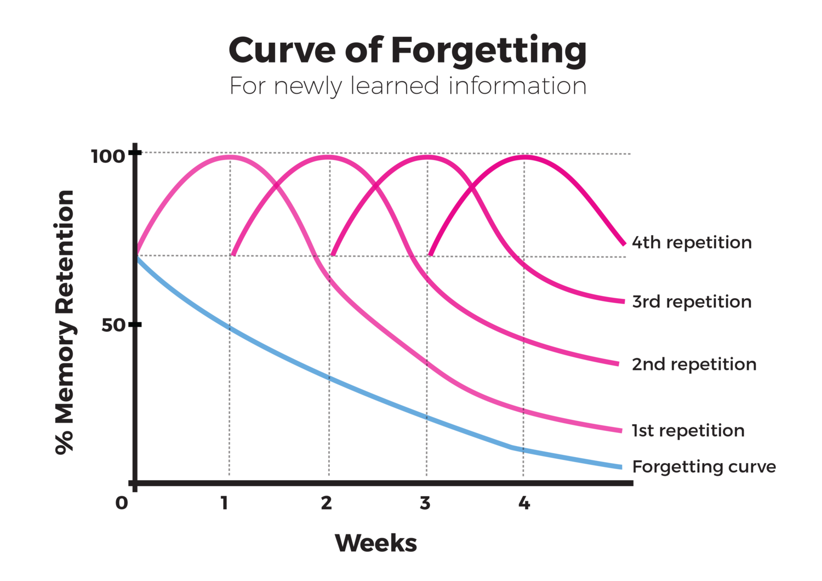
memory
Did you know that if you don’t regularly study, you very quickly forget everything you’ve learned?
After 2 weeks, you’ve already forgotten half of what you learned!
Each time you go over things again, you’re twice as likely to remember things you’ve learned about!

Slide 12
How to study long-term
Make posters and pin them up in the toilet!
Make flash cards and review them on the bus
When you get home, write a summary of everything you’ve learned
Go over your notes with a highlighter – make your page look like a rainbow!

Slide 13
Aims
Learning Intentions:
We will be learning about how to prepare ourselves for our topic test
Success Criteria:
We will be able to use our program to revise
We will be able to draw a graphic organiser to figure out what we do and don’t know

